Slide 1
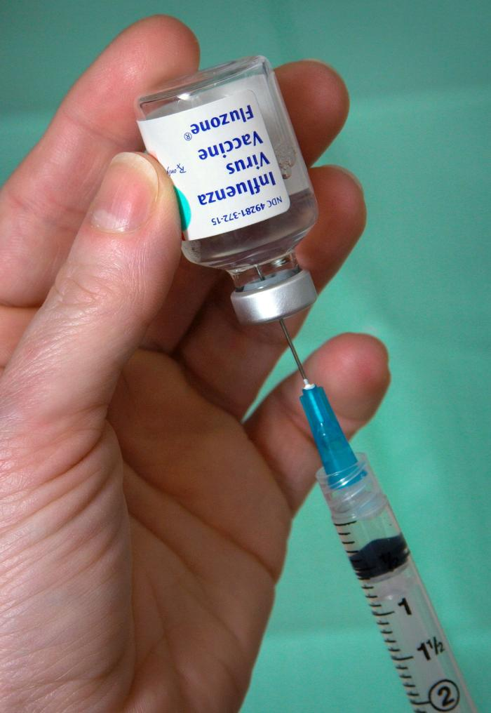
Flu Shot Learning: Predict Seasonal Flu Vaccines
ML
FLU SHOT LEARNING
BY
SEGO MICH
This Photo by Unknown Author is licensed under CC BY-SA-NC

Slide 2
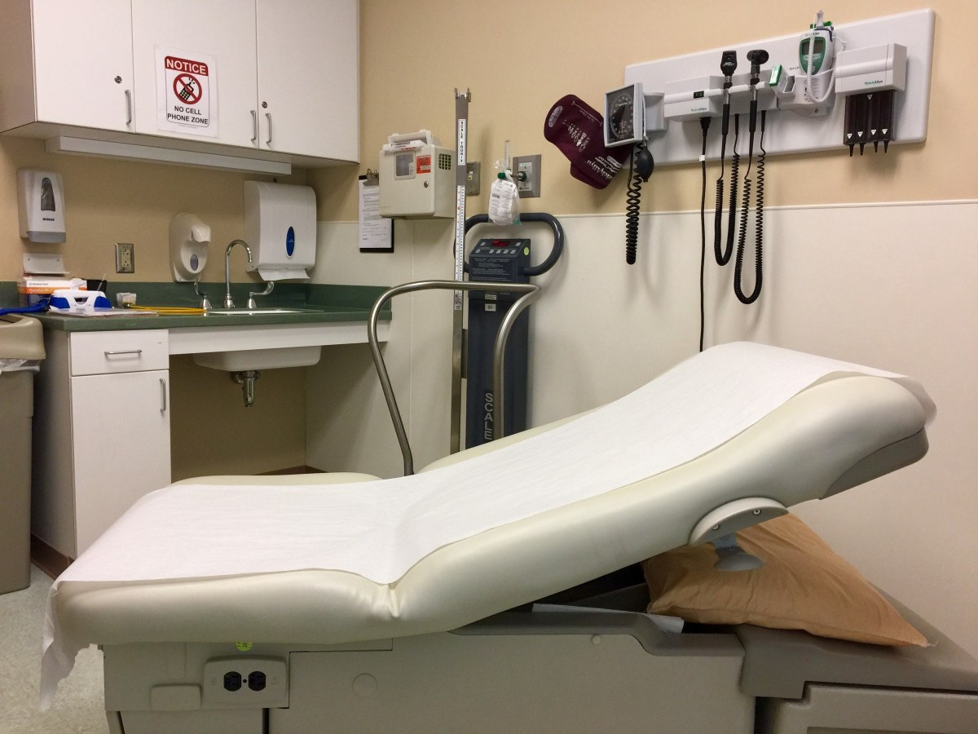
OVERVIEW OF THE PROJECT
Project Overview
Analysis of Vaccination Patterns from the National 2009 Seasonal Flu Survey

Slide 3
Business problem
A vaccine for the H1N1 flu virus became publicly available in October 2009. In late 2009 and early 2010, the United States conducted the National 2009 H1N1 Flu Survey.
This phone survey asked respondents whether they had received the H1N1 and seasonal flu vaccines, in conjunction with questions about themselves.
These additional questions covered their social, economic, and demographic background, opinions on risks of illness and vaccine effectiveness, and behaviors towards mitigating transmission.
A better understanding of how these characteristics are associated with personal vaccination patterns can provide guidance for future public health efforts.

Slide 4
Objectives
Main Objective To analyze the demographic characteristics of respondents, including age, education, income, employment, and household composition.
Specific Objectives
Age Distribution – Examine the age group distribution among respondents.
Educational Attainment – Analyze the levels of education across different respondents.
Income and Employment Status – Assess variations in income levels and employment status.
Household Composition – Investigate household structure based on marital status, homeownership, and number of adults/children.
Geographic Demographics – Identify demographic variations across different regions.

Slide 5
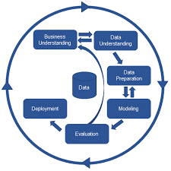
Methodology
CRISP-DM
Business Understanding
Data Understanding
Data Preparation
Modeling
Evaluation

Slide 6
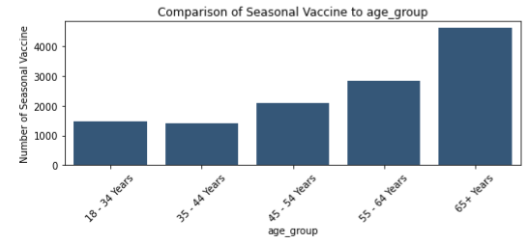
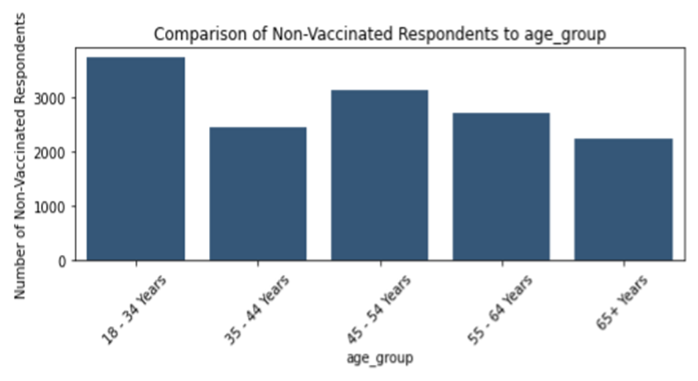
Comparison of seasonal vaccine per age group
65+ Years are most vaccinated
18 – 34 Years are most non vaccinated

Slide 7
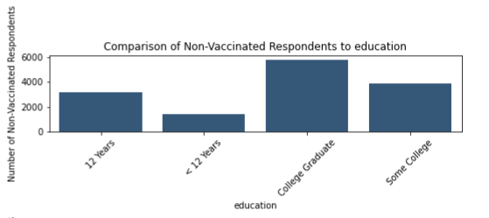
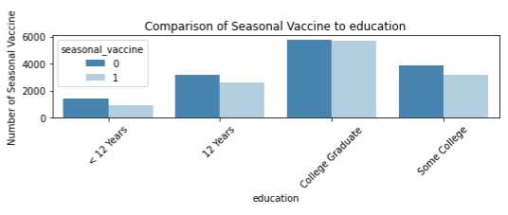
Comparison of seasonal vaccine per education level
In the survey College Graduate are most vaccinated
All education levels aremore non vaccinated than vaccinated.

Slide 8
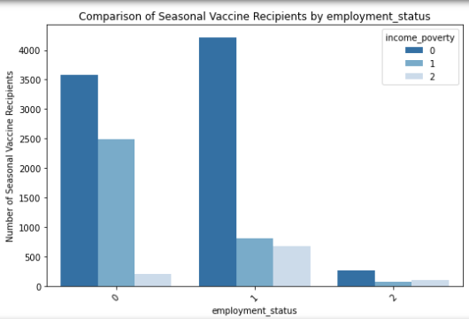
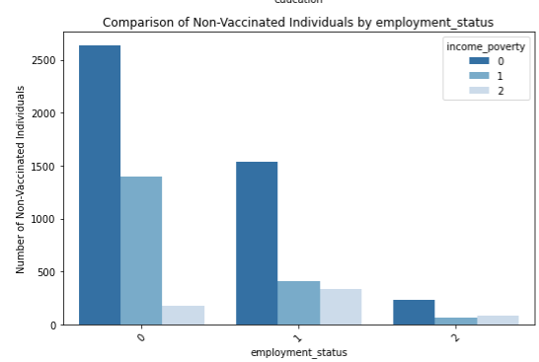
Comparison of seasonal vaccine per income poverty and employment status
In the survey College Graduate are most vaccinated
College graduate are most non vaccinated also.

Slide 9
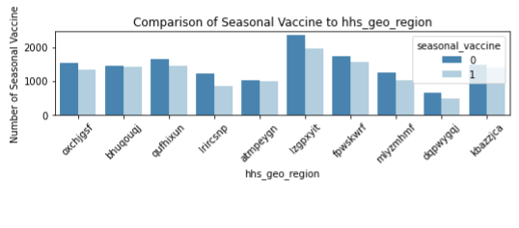
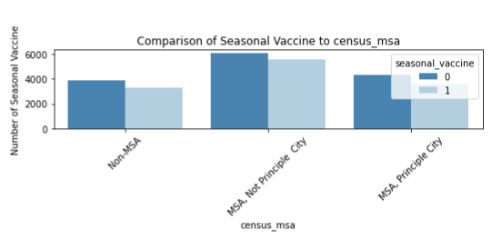
Comparison of seasonal vaccine per household composition
In the survey all regions most respondents do not take most vaccines as those who do.
In the survey all regions most respondents do not take most vaccines as those who do.

Slide 10
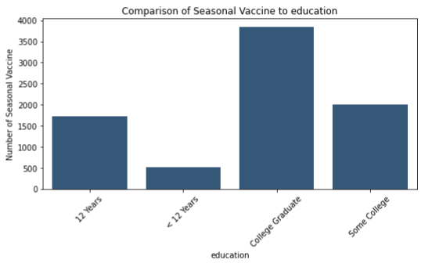
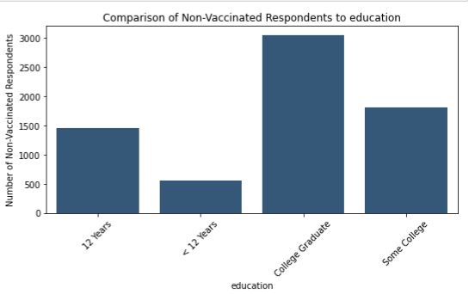
Comparison of seasonal vaccine per geographic composition
In the survey College Graduate are most vaccinated
College graduate are most non vaccinated also.

Slide 11
Tools and Libraries
MATHEMATICAL | VISUALIZATION | PREPROCESSING | MODELLING | METRICS
Pandas | Seaborn | LabelEncoder | Logistic Regression | Accuracy
Numpy | Matplotlib |  | Decision Tree Classifier
 |  |  | Random Forest Classifier
 |  |  | Support Vector Classifier
 |  |  | Naive Bayes

Slide 12

Conclusion
Logistic Regression: 0.63 Accuracy
Decision Tree Classifier 0.59 Accuracy
Random Forest: 0.60 Accuracy
Support Vector Machine (SVM): 0.62 Accuracy
Naive Bayes: 0.62 Accuracy
Logistic Regression achieved the highest accuracy at 0.63, making it the best-performing model. Decision Tree Classifier had the lowest accuracy at 0.59. Random Forest Naive Bayes and SVM performed similarly with accuracies of 0.60, 0.62 and 0.62, respectively.
This Photo by Unknown Author is licensed under CC BY

Slide 13
Thank You.
ML
ML
Sego Mich
FLU SHOT LEARNING
FLU SHOT LEARNING
2547XXXXXX
mich.sego@student.moringaschool.com
https://github.com/Sego-Mich/mich_phase_3_final_project

